Slide 1
Lending Club Loan Data Analysis & Risk Insights
Exploratory data analysis & credit risk patterns

Slide 2
Problem Statement
Lending club provides peer to peer loans to borrowers
Objective is to understand loan default behavior
Identify patterns that separate good vs risky borrowers
Goal : Use EDA to uncover factors influencing loan default risk

Slide 3
Data Overview
Data Source : Lending Club (Public Loan Data)
Total records : Number of rows – 397171 & number of columns – 111
Target Variable : loan_status (fully paid , charged off , default)
Data Type : Borrower, Loan & Credit Attributes

Slide 4
Data Cleaning & Preprocessing
Removed irrelevant and high-missing-value columns
Handled missing values using appropriate strategies
Converted categorical variable to usable formats
Transformed interest rate and term into numeric values
Ensured consistency in loan status categories

Slide 5
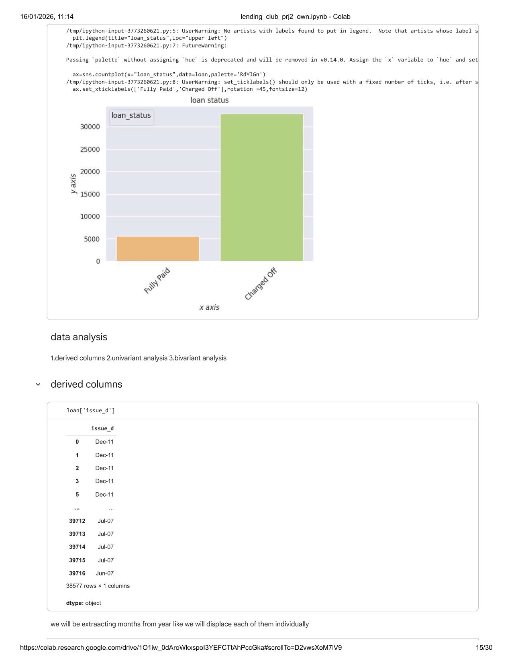
Loan Status Distribution
Majority of the loans are fully paid with 85.41 %
A significant portion of loans are charged off
Indicates class imbalance in loan outcome

Slide 6
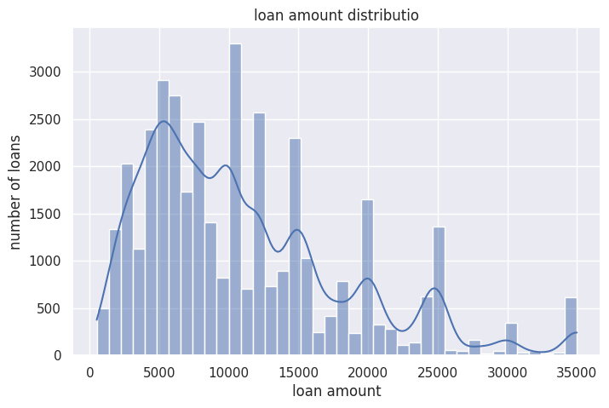
Loan Amount Distribution
Most loan fall within a moderate loan amount range
Very high loan amount are comparatively rare
Distribution shows right skewed behavior

Slide 7
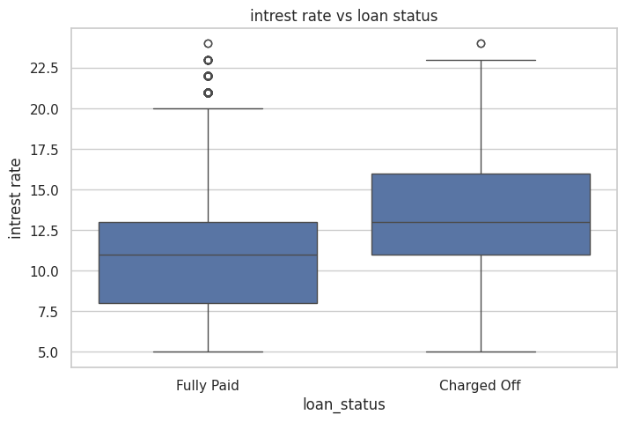
Interest rate vs Loan Status
Charged off loans shows higher median interest rates
Higher interest rate are associated with the higher default risk
Confirms risk-based pricing strategy

Slide 8
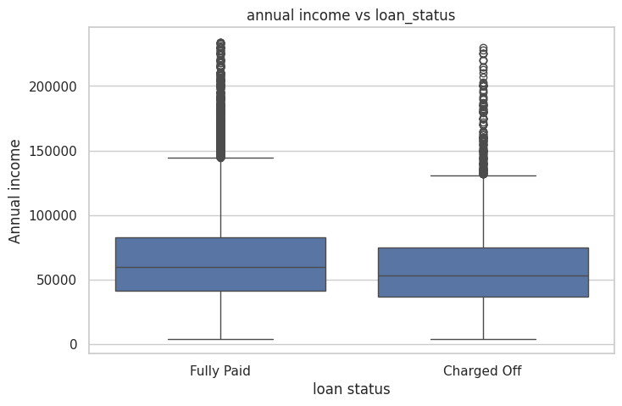
Annual Income vs Loan Status
Fully paid loans tends to have higher median income
Lower income borrower shows higher default risk
Income stability plays a key role in repayment

Slide 9
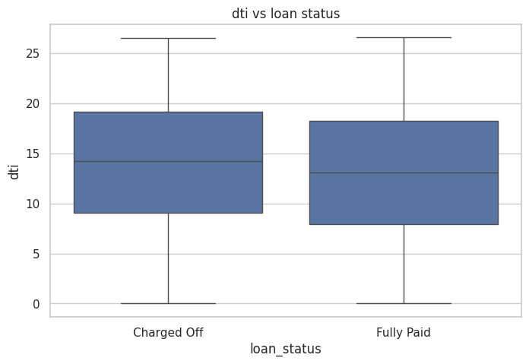
Debt-to-Income vs Loan Status
Charged off loans shows higher dti values
Higher debt burden increases default risk
DTI is a strong indicator of borrower financial stress

Slide 10

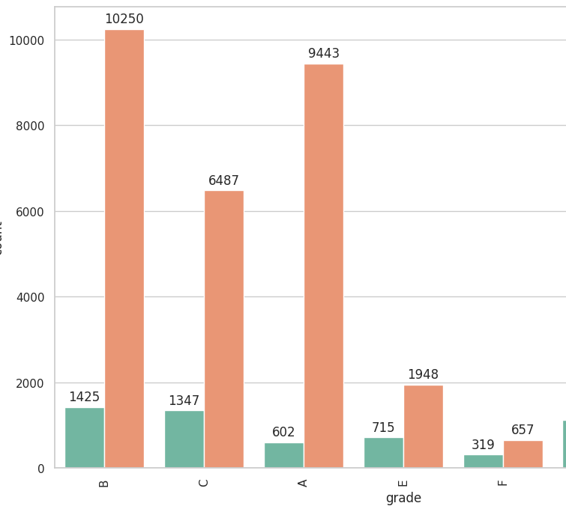
Loan Grade vs Loan Status
Higher grade loans (A,B) shows higher default counts due to large loan volume
Lower grades have fewer loans but higher relative risk
B=11675,A=10045,C=7834,D=5085,E=2663,F=976,G=229

Slide 11
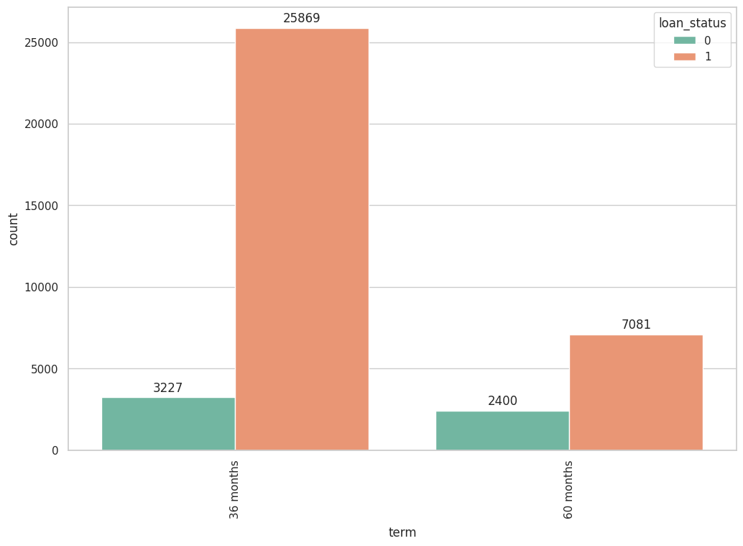
Term vs Loan Status
Here there are lower no of applicants for a longer duration but also even though the number is less than too default rates are high
60 months loan shows a higher default risk
Longer loan tenure increases the exposure to risk
Shorter term loans are relatively safer

Slide 12
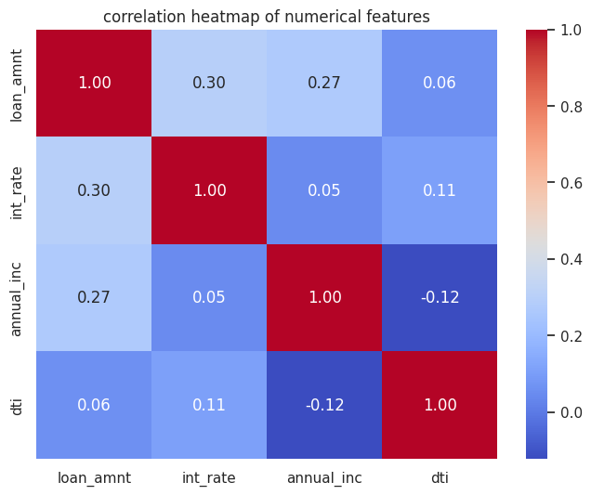
Correlation Analysis
Interest rate shows relationship with risk related variable
Loan amount and income are moderate correlation
No extreme multicollinearity observed

Slide 13
Key Insights !
Higher interest rate are associated with higher default risk
Borrowers with the higher income shows better repayment behavior
High debt-to-income ratios indicates increased default probability
Lower loan grade exhibit higher relative default risk
Longer loan tenure increases exposure to default risk

Slide 14
Business Implications & Recommendation
Strengthen screening for the borrowers with high debt-to-income ratio
Apply stricter monitoring for long term(60 months) loans
Enhance risk based pricing for the mid to low loan grade
Encourage lower risk borrowers through competitive interest rate

Slide 15
Limitations
Analysis is exploratory and does not imply causation
External economics factors were not included in the dataset
Some variables contains missing values and outliers

Slide 16
Conclusion
Loan defaults are influenced by the borrowers financial stability and loan structure
Interest rate , income , debt to income ratio and the grade as the key risk indicators
EDA provides valuable direction for the credit risk assessment

Slide 17
Tools & Technology
Python
Pandas , NumPy
Matplotlib, Seaborn
Google Collab

Slide 18
Thank you !
GitHub : GitHub.com/somaiyavehan /Lending-Club-Analysis

